Slide 1
CMSC201 Computer Science I for Majors Lecture 20 – Project 3 and Miscellaneous Topics

Slide 2
Last Class We Covered
Dictionaries
Creating
Accessing
Manipulating
Methods
Hashing
Dictionaries vs Lists

Slide 3
Any Questions from Last Time?

Slide 4
Today’s Objectives
To understand more about how data is represented inside the computer
Binary numbers
To see the benefits of short circuit evaluation
To discuss details of Project 3
How many boards to have?

Slide 5
Binary Numbers

Slide 6
Binary Numbers
Computers store all information (code, text, images, sound,) as a binary representation
“Binary” means only two parts: 0 and 1
Specific formats for each file help the computer know what type of item/object it is
But why use binary?

Slide 7
Decimal vs Binary
Why do we use decimal numbers?
Ones, tens, hundreds, thousands, etc.
But computers don’t have fingers…
What do they have instead?
They only have two states: “on” and “off”

Slide 8
Decimal Example
How do we represent a number like 50,932?
2 x 10⁰ = 2
3 x 10¹ = 30
9 x 10² = 900
0 x 10³ = 0000
5 x 10⁴ = 50000
------
Total: 50932
ten thousands
thousands
hundreds
tens
ones
5
0
9
3
2
10⁴
10³
10²
10¹
10⁰
Decimal uses 10 digits, so…

Slide 9
Another Decimal Example
6 | 7 | 4 | 9 | 3
10⁴ | 10³ | 10² | 10¹ | 10⁰
10000 | 1000 | 100 | 10 | 1
60000 | 7000 | 400 | 90 | 3
60000+7000+400+90+3 = 67493

Slide 10
Binary Example
Let’s do the same with 10110 in binary
0 x 2⁰ = 0
1 x 2¹ = 2
1 x 2² = 4
0 x 2³ = 0
1 x 2⁴ = 16
--
Total: 22
sixteens
eights
fours
twos
ones
1
0
1
1
0
2⁴
2³
2²
2¹
2⁰
Binary uses 2 digits, so our base isn’t 10, but…

Slide 11
Binary to Decimal Conversion
Step 1: Draw Conversion Box
Step 2: Enter Binary Number
Step 3: Multiply
Step 4: Add
2⁹ | 2⁸ | 2⁷ | 2⁶ | 2⁵ | 2⁴ | 2³ | 2² | 2¹ | 2⁰
512 | 256 | 128 | 64 | 32 | 16 | 8 | 4 | 2 | 1
1 | 0 | 1 | 0 | 0 | 0 | 1 | 1 | 0 | 1
512 | 0 | 128 | 0 | 0 | 0 | 8 | 4 | 0 | 1
128 + 0 + 0 + 0 + 8 + 4 + 0 + 1 = 141

Slide 12
Exercise: Converting From Binary
What are the decimals equivalents of…
101
1111
100000
101010
0010 1010
1000 0000
Longer binary numbers are often broken into blocks of four digits for the sake of readability

Slide 13
Exercise: Converting From Binary
What are the decimals equivalents of…
101 = 4+0+1 = 5
1111 = 8+4+2+1 = 15
100000 = 32+0+0+0+0+0 = 32
101010 = 32+0+8+0+2+0 = 42
0010 1010 = 32+0+8+0+2+0 = 42
1000 0000 = 128+...+0+0 = 128

Slide 14
Decimal to Binary Conversion
Step 1: Draw Conversion Box
Step 2: Compare decimal to highest binary value
Step 3: If binary value is smaller, put a 1 there and
subtract the value from the decimal number
Step 4: Repeat until 0
Convert 163 to binary
2⁹ | 2⁸ | 2⁷ | 2⁶ | 2⁵ | 2⁴ | 2³ | 2² | 2¹ | 2⁰
512 | 256 | 128 | 64 | 32 | 16 | 8 | 4 | 2 | 1
1 | 0
1 | 0 | 0 | 0
1
1
163-128 = 35
35-32 = 3
3-2=1
1-1=0

Slide 15
Converting to Binary
What are the binary equivalents of…
9
27
68
216
255

Slide 16
Converting to Binary
What are the binary equivalents of…
9 = 1001 (or 8+1)
27 = 0001 1011 (or 16+8+2+1)
68 = 0100 0100 (or 64+4)
216 = 1101 1000 (or 128+64+16+8)
255 = 1111 1111 (or 128+64+32+16+8+4+2+1)

Slide 17
Binary Tips and Tricks
Some “sanity checking” rules for conversions:
Binary can only be 1 or 0
If you get “2” of something, it’s wrong
Odd numbers must have a 1 in the ones column
Why? (And what’s the rule for even numbers?)
Each column’s value is the sum of all of the previous columns (to the right) plus one
In decimal, what column comes after 999?

Slide 18
“Short Circuit” Evaluation

Slide 19
Review: Complex Expressions
We can put multiple operators together!
bool4 = a and (b or c)
What does Python do first?
Computes (b or c)
Computes a and the result
This isn’t strictly true!

Slide 20
Short Circuit Evaluation
Python tries to be efficient (i.e., lazy), and so it won’t do any more work than necessary
If the remainder of an expression won’t change the outcome, Python doesn’t look at it
This is called “short circuiting”
It’s a powerful tool, and can simplify the conditionals in your programs

Slide 21
Short Circuit Evaluation – Rules
For obvious reasons, short circuiting behaves differently for and and or statements
“and” statements short circuit as soon as an expression evaluates to False
“or” statements short circuit as soon as an expression evaluates to True

Slide 22
Short Circuiting – and
Notice that in the expression:
bool1 = a and (b or c)
If a is False
The rest of the expression doesn’t matter
Python will realize this, and if a is False won’t bother with the rest of the expression

Slide 23
Short Circuiting – or
Notice that in the expression:
bool1 = a or (b or c)
If a is True
The rest of the expression doesn’t matter
Python will realize this, and if a is True won’t bother with the rest of the expression

Slide 24
Causing Errors
This can lead to “new” errors in old code
>>> a = True
>>> # Variables b and c not defined
>>> a or (b and c)
True
>>> a = False
>>> a or (b and c)
Traceback (most recent call last):
File "<stdin>", line 1, in <module>
NameError: name 'b' is not defined
Python stopped at the “or”, so it never saw b or c

Slide 25
Simplifying Conditionals
Order matters! You can use short circuiting to control what statements are reached
While checking the validity of input, if the user can also enter a “Q” to quit
if num != QUIT and int(num) > MIN_VAL:
return num
This will only be reached if num is not “Q”, so the cast to int() won’t cause a problem

Slide 26
Project 3

Slide 27
Do Not Cheat on Project 3
Yes, this project has been given before
Yes, in this class
Yes, we have all of the old projects to compare it to
Yes, this project has solutions on the internet
Yes, we have copies of all of them
Yes, we will go looking for new ones after it’s due
Yes, you could pay someone else to do it
Yes, we know of the sites where you can get this done
Yes, we will spot “elegant” code that you didn’t write

Slide 28
Boards in Project 3
Discussed in class
¯\_(ツ)_/¯

Slide 29
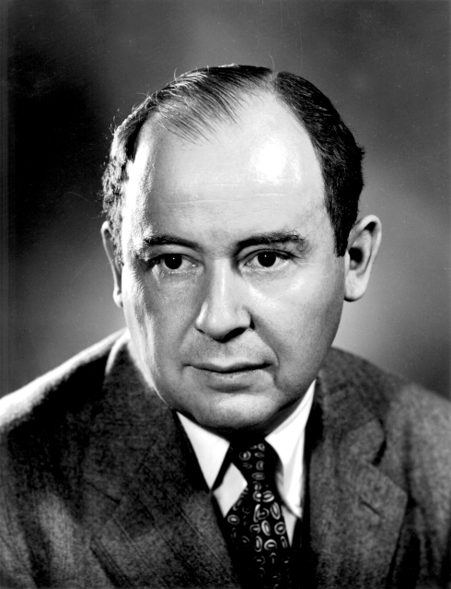
Daily CS History
John von Neumann
Creator of merge sort
We’ll learn this soon!
Helped develop what is now known as “von Neumann architecture” (not all his work)
Created a rigorous framework for quantum mechanics
Developed implosion mechanism for nuclear bombs

Slide 30
More Daily CS History
ENIAC
Completed in 1946 at UPenn
Decommissioned in 1956
Computations were 2,400 times faster than humans
Cost $6.7 million to build
Meant to create artillery firing tables for the US Army
Also used for studying thermonuclear feasibility

Slide 31
Even More Daily CS History
ENIAC Programmers
Kay McNulty, Betty Jennings, Betty Snyder, Marlyn Meltzer, Fran Bilas, and Ruth Lichterman
These women turned abstract ideas into working, bug-free code
First program run on ENIAC had a million individual punchcards
Programming was seen back then as “easy” work, akin to typing up a handwritten letter

Slide 32
Announcements
Project 3 design is due on Friday, May 3rd
Project itself is due on Friday, May 10th
Survey #3 out on Monday, May 6th
Course evaluations are (not out yet)
Final exam is when?
Friday, May 17th from 6 to 8 PM

Slide 33
Image Sources
ASCII table (adapted from):
https://commons.wikimedia.org/wiki/File:ASCII-Table-wide.svg
Generic kitten:
http://www.publicdomainpictures.net/view-image.php?image=87454
Generic puppy:
http://www.publicdomainpictures.net/view-image.php?image=192231
John von Neumann:
https://en.wikipedia.org/wiki/File:JohnvonNeumann-LosAlamos.gif
ENIAC (adapted from):
https://commons.wikimedia.org/wiki/File:Eniac.jpg
ENIAC programmers (adapted from):
https://commons.wikimedia.org/wiki/File:Reprogramming_ENIAC.png
Mad emoji (adapted from):
https://commons.wikimedia.org/wiki/File:Twemoji_1f620.svg

